Slide 1
Рефакторинг. Усовершенствование готовой программной системы.
Лекция 12

Slide 2
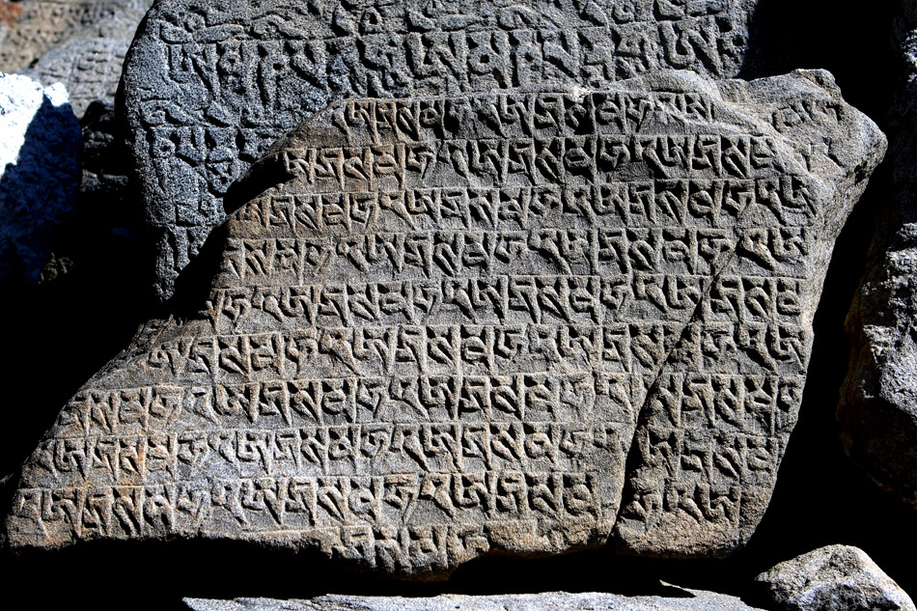
Теория: требования не меняются!

Slide 3
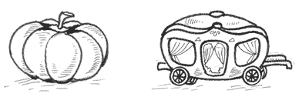
Реальность

Slide 4
Эволюция ПО
Повышение и снижение качества
Время внесения измнений
Эволюция ПО неизбежный процесс

Slide 5
Рефакторинг
изменение внутренней структуры ПО без изменения его наблюдаемого поведения, призванное облегчить его понимание и удешевить модификацию
Мартин Фаулер
Код «пахнет»

Slide 6
Почему возникает необходимость в рефакторинге?

Slide 7
Унаследованный код
int i=15;
if(i<20){int k = i*154;}
String s = String.valueOf(i);
char ch=s.charAt(2);
while(ch > 0){
System.out.println(ch);
O.s();
}
O o = new O();
o.toString();

Slide 8

Осмотр результатов своего труда

Slide 9
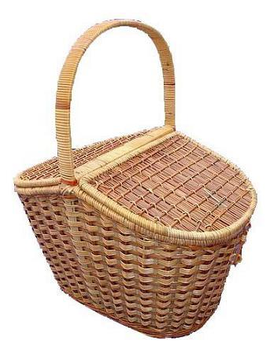
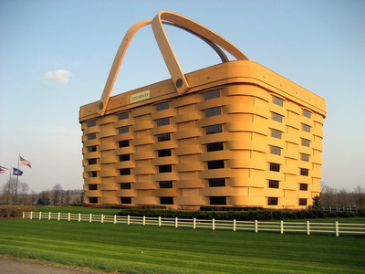
Инкрементальный дизайн

Slide 10
Каталог рефакторинга http://refactoring.com/catalog/index.html
Add Parameter
Change Bidirectional Association to Unidirectional
Change Reference to Value
Change Unidirectional Association to Bidirectional
Change Value to Reference
Collapse Hierarchy
Consolidate Conditional Expression
Consolidate Duplicate Conditional Fragments
Convert Dynamic to Static Construction by Gerard M. Davison
Convert Static to Dynamic Construction by Gerard M. Davison
Decompose Conditional
Duplicate Observed Data
Eliminate Inter-Entity Bean Communication (Link Only)
Encapsulate Collection
Encapsulate Downcast
Encapsulate Field
Extract Class
Extract Interface
Extract Method
Extract Package by Gerard M. Davison
Extract Subclass
Extract Superclass
Form Template Method
Hide Delegate
Hide Method
Hide presentation tier-specific details from the business tier (Link Only)
Inline Class
Inline Method
Inline Temp
Introduce A Controller (Link Only)
Introduce Assertion
Introduce Business Delegate (Link Only)
Introduce Explaining Variable
Introduce Foreign Method
Introduce Local Extension
Introduce Null Object
Introduce Parameter Object
Introduce Synchronizer Token (Link Only)
Localize Disparate Logic (Link Only)
Merge Session Beans (Link Only)
Move Business Logic to Session (Link Only)
Move Class by Gerard M. Davison
Move Field
Move Method
Parameterize Method
Preserve Whole Object
Pull Up Constructor Body
Pull Up Field
Pull Up Method
Push Down Field
Push Down Method
Reduce Scope of Variable by Mats Henricson
Refactor Architecture by Tiers (Link Only)
Remove Assignments to Parameters
Remove Control Flag
Remove Double Negative by Ashley Frieze and Martin Fowler
Remove Middle Man
Remove Parameter
Remove Setting Method
Rename Method
Replace Array with Object
Replace Assignment with Initialization by Mats Henricson
Replace Conditional with Polymorphism
Replace Conditional with Visitor by Ivan Mitrovic
Replace Constructor with Factory Method
Replace Data Value with Object
Replace Delegation with Inheritance
Replace Error Code with Exception
Replace Exception with Test
Replace Inheritance with Delegation
Replace Iteration with Recursion by Dave Whipp
Replace Magic Number with Symbolic Constant
Replace Method with Method Object
Replace Nested Conditional with Guard Clauses
Replace Parameter with Explicit Methods
Replace Parameter with Method
Replace Record with Data Class
Replace Recursion with Iteration by Ivan Mitrovic
Replace Static Variable with Parameter by Marian Vittek
Replace Subclass with Fields
Replace Temp with Query
Replace Type Code with Class
Replace Type Code with State/Strategy
Replace Type Code with Subclasses
Reverse Conditional by Bill Murphy and Martin Fowler
Self Encapsulate Field
Separate Data Access Code (Link Only)
Separate Query from Modifier
Split Loop by Martin Fowler
Split Temporary Variable
Substitute Algorithm
Use a Connection Pool (Link Only)
Wrap entities with session (Link Only)

Slide 11
Пример 1

Slide 12
Rename
Изначально неверное наименование
Поведение объекта изменилось с течением времени

